Slide 1


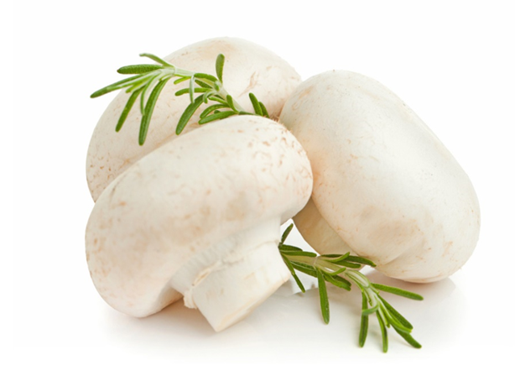

Literature report
Reporter：Ying Limei
FOOD SCIENCE COLLEGE OF SYAU
食品学院

Slide 2
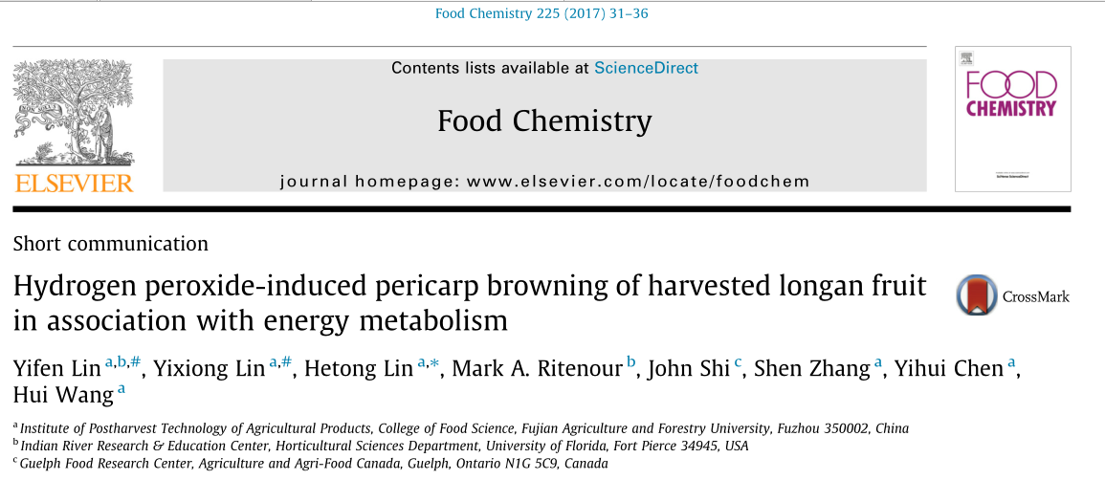
过氧化氢诱导的龙眼果实果皮褐变与能量代谢相关
FOOD SCIENCE COLLEGE OF SYAU
食品学院

Slide 3

Abstract
Energy metabolism of “Fuyan” longan fruit treated with hydrogen peroxide (H₂O₂), the most stable of the reactive oxygen, and its relationship to pericarp（果皮） browning were investigated in this work.The results displayed that H₂O₂ significantly decreased contents of ATP and ADP. The treatment of H₂O₂ accelerating pericarp browning in harvested longans was due to a decrease of ATPase activity and available ATP content.This might break the ion homeostasis(离子稳态) and the integrity of mitochondria(线粒体), which might reduce energy charge（能量电荷） and destroy the function and compartmentalization（分隔） of cell membrane. These together aggravated browning incidence in pericarp of harvested longan fruit.
Determination of ATP, ADP , AMP contents and ATPase activity
FOOD SCIENCE COLLEGE OF SYAU
食品学院

Slide 4
Results and discussion
①.H₂O₂-induced changes in contents of ATP, ADP and AMP in pericarp of harvested longan fruit
ATP is the main source of energy for metabolism regulation,the energy deficit caused by declined ATP synthesis is one of the main causes for membrane damage and browning of postharvest horticultural products .At harvest, longan fruit contained high levels of ATP and ADP, but relatively low AMP content. With the extension of storage, ATP and ADP levels reduced, whereas AMP content elevated. H₂O₂-treated longan fruit maintained lower contents of ATP and ADP , but higher AMP content , pericarp browning index and ion leak rate . These indicated that H₂O₂ accelerated the incidence of longan pericarp browning by enhancing the decrease in ATP, speeding up the process of membrane damage.
FOOD SCIENCE COLLEGE OF SYAU
食品学院

Slide 5
②.H₂O₂-induced changes in ATPase activity in pericarp of harvested longan fruit
Magnesium (Mg) is a crucial cofactor of a variety of enzymes involved in respiration metabolism and energy metabolism,Ca²⁺-ATPase and Mg²⁺-ATPase are crucial for cellular homeostasis.The redundant accumulation(过度积累) of Ca²⁺and Mg²⁺in cytoplasm will break the environment balance and damage the structure of mitochondria（线粒体）, vacuole（液泡）, and even the whole cell.Once their structures are damaged, their function will be in disorder and the synthesis of energy will be restrained. Thus, it will lead to energy deficiency and accelerate aging and death of plant. It can be referred that ATPase activity in membranes of plasma, mitochondria and vacuole play an important part in browning of postharvest crops.
FOOD SCIENCE COLLEGE OF SYAU
食品学院

Slide 6

Conclusions
In short, this study demonstrated that browning of harvested longans was closely associated with energy metabolism. The acceleration of pericarp browning caused by H₂O₂ might be due to H₂O₂ reducing levels of H⁺-ATPase and Ca²+-ATPase in membranes of plasma(质膜）, mitochondria（线粒体） and vacuole（液泡）, lowing activities of Mg²+ATPase in plasma membrane and vacuole membrane,and decreasing ATP level. These together may result in the imbalances of internal environment and the alterations of property and integrity in mitochondria, vacuole and the whole cell. These might directly or indirectly induce the disorders of metabolism, which, in turn, injuring to the cell membranes and organelles, and thus accelerating browning in pericarp of harvested longan fruit.
FOOD SCIENCE COLLEGE OF SYAU
食品学院

Slide 7
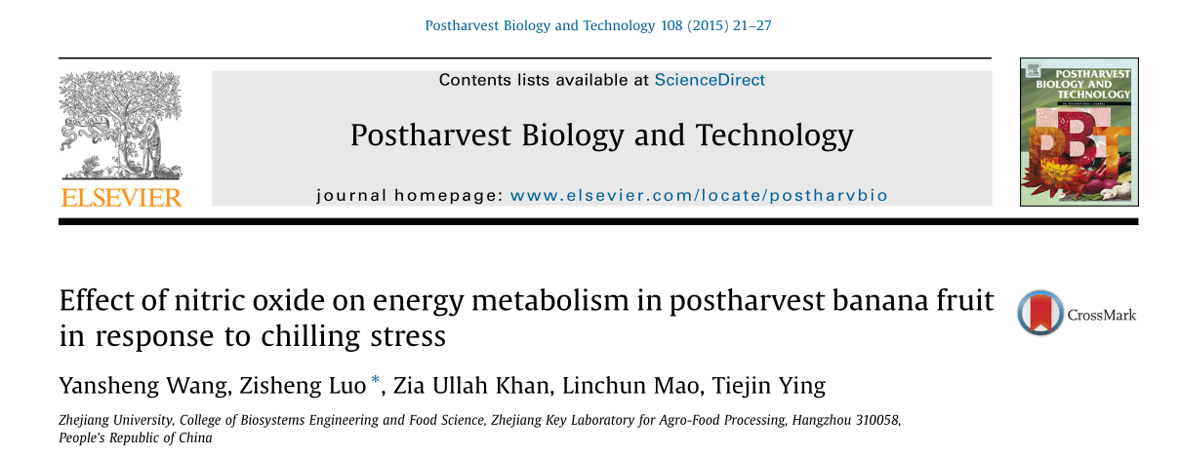
一氧化氮对采后香蕉果实冷害能量代谢的影响
FOOD SCIENCE COLLEGE OF SYAU
食品学院

Slide 8

Abstract
Effects of postharvest nitric oxide (NO) treatment on energy metabolism and chilling injury in cold-stored banana fruit were investigated. The contents of ATP and energy charge in the NO-treated fruit were significantly higher than control fruit. Meanwhile, the activities of enzymes involved in energy metabolism were markedly enhanced by NO treatment. In addition, notably elevated activities of fructokinase（果糖激酶）, glucokinase（葡萄糖激酶）, glucose-6-phosphate dehydrogenase（6-磷酸葡萄糖脱氢酶） and 6-phosphogluconate dehydrogenase（6-磷酸葡萄糖酸酯脱氢酶） were observed in NO-treated banana fruit. These results indicated that NO could enhance chilling tolerance of banana fruit through maintaining high levels of energy status and inducing enzyme activities involved in energy metabolism during cold storage.
FOOD SCIENCE COLLEGE OF SYAU
食品学院

Slide 9
Material and methods
The selected fingers were randomly divided into two groups of 240.
（1）First group: 0.05 mM sodium nitroprusside (SNP) solution , 30 L sealed vacuum container, low pressure (10 kPa) for 5 min (NO).
（2）Second group : sterile deionized water under the same conditions (Control).
（3）The banana fruit of the two groups were placed into unsealed polyethylene bags (0.04 mm) and stored at 7℃ for 20 day.A sample of nine fruit was randomly collected at a period of 5 day.
（4）The peels of the selected fruit were cut into pieces, frozen in liquid nitrogen and stored at -80℃ for the subsequent analysis of energy status and enzyme activities.
CI index assessment（表面冷害程度）、electrolyte leakage、mitochondrial ATPase(线粒体ATP酶)、cytochrome C oxidase (CCO) activity细胞色素C氧化酶(CCO)活性、
succinate dehydrogenase (SDH) activity（琥珀酸脱氢酶(SDH)活性）、
ATP, ADP and AMP contents and energy charge（ATP、ADP、AMP含量与能荷）.
FOOD SCIENCE COLLEGE OF SYAU
食品学院

Slide 10

Discussion
Cellular energy is a crucial factor in controlling ripening and senescence(成熟和衰老) of postharvest horticultural products,Cellular energy may directly affect the biosynthesis of membrane lipids and cell membrane restoration（修复）.The results indicated that NO-treated banana fruit had an elevated chilling tolerance to low temperature stress（NO处理的香蕉果实对低温胁迫的耐寒性增强）. Higher resistance of banana fruit to chilling stress was related to higher levels of ATP and energy charge, which can be attributed to the more active energy metabolism（代谢）. It is suggested that energy metabolism associated with metabolic pathways such as glycolysis, OPP pathway and TCA cycle, may be involved in the chilling resistance of banana fruit.
FOOD SCIENCE COLLEGE OF SYAU
食品学院

Slide 11
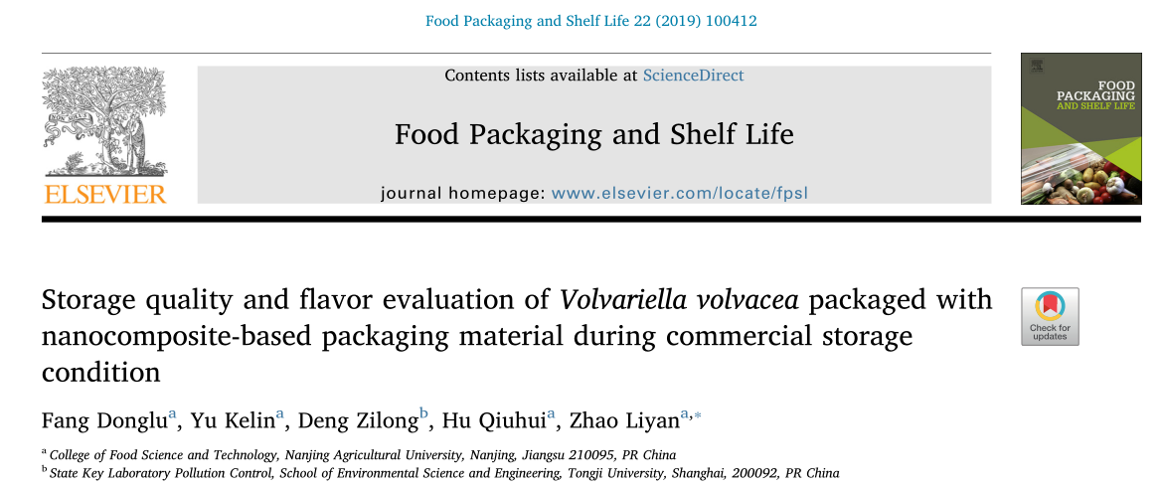
纳米复合包装材料包装草菇商业贮藏品质及风味评价
FOOD SCIENCE COLLEGE OF SYAU
食品学院

Slide 12

Abstract
This research was designed to demonstrate the effectiveness of nanocomposite-based packaging (NP) treatment for straw mushrooms (Volvariella volvacea).The respiratory rate, total soluble solids (TSS),firmness, colour, reactive oxygen species (ROS) and flavor properties of V. volvacea were investigated.The results showed that the browning, softening and respiration rate of V. volvacea were significantly inhibited by NP treatment. NP could be potentially applied to improve the postharvest storability and extend the storage shelf life of V. volvacea.
FOOD SCIENCE COLLEGE OF SYAU
食品学院

Slide 13

Mushroom and storage condition:15 ± 1℃ and 85 ± 5% relative humidity (RH)for 1 h,packaged in the NP and CP (18 bags,135 g/bag) and the packages were sealed with a heat sealer.
The V. volvace packed with NP and CP were stored at 15 ± 1 °C and 85 ± 5% RH for 6 days.
Measurement standard:Colour change；Firmness and total soluble solid (TSS)；
Respiration rate（呼吸速率）；O₂•− generation rate, H₂O₂ and MDA content；
Microstructure observation(显微组织观察); Volatile flavor compounds（挥发性风味化合物） ；
Non-volatile flavor compounds measurement：Organic acid （有机酸）、Soluble sugar （可溶性糖）、 5ʹ-nucleotides（5ʹ-核苷酸）、Free amino acids （游离氨基酸）.
FOOD SCIENCE COLLEGE OF SYAU
食品学院

Slide 14

Conclusions
In conclusion, the developed NP postharvest treatment for V. vol-
vacea reduced the browning degree, respiration rate, MDA content and
ROS levels compared to those of CP treatment. Mushrooms packed in
NP retained firmness, total soluble solids and flavor compounds.
Therefore, it was demonstrated that NP delayed the senescence of V.
volvacea. As a minimal processing technology, NP could be one of the
potential commercial approaches for the postharvest mushroom in-
dustry to improve storability and maintain shelf life.
FOOD SCIENCE COLLEGE OF SYAU
食品学院

Slide 15
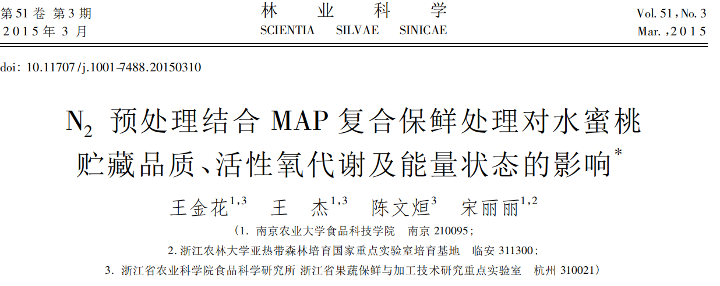
关键词: 水蜜桃; 充氮处理; 自发气调包装; 营养品质; 活性氧代谢; 能量
FOOD SCIENCE COLLEGE OF SYAU
食品学院

Slide 16
摘 要
复合贮藏保鲜是将 2 种及以上的贮藏保鲜方法相结合，可实现优势互补，达到理想保鲜效果的目的 。氮气处理引起的超低氧胁迫可以抑制呼吸作用和乙烯生产，减轻果蔬生理病害，延缓果实后熟和衰老进程，是近年来应用前景较好的一种保鲜技术。本研究采用充氮预处理结合 MAP 处理对“湖景蜜露”水蜜桃低温贮藏以及货架期间营养品质、抗氧化系统及能量水平的影响。
材料和方法
果实经 100% N₂ 处理 6 h 后，用厚度0. 02 mm的聚乙烯薄膜袋密封包装，对照组不做任何处理。所有果实均置于( 1 ± 1) ℃ 相对湿度 85% ～ 90% 保鲜库中，贮藏 30 天后，从薄膜袋取出，置于( 25 ± 1) ℃ 下模拟货架期。
FOOD SCIENCE COLLEGE OF SYAU
食品学院

Slide 17
测量指标
1.腐烂指数、硬度及可溶性固形物( TSS) 和维生素 C( Vc) 含量测定
2.过 氧 化 氢 ( H2O2 ) 含量和超氧阴离子( O₂．－ ) 产 生速率 测 定
3.超氧化物歧化酶( SOD) 、过氧化氢酶( CAT)及脂氧合酶( LOX) 活性测定
4.膜透性及丙二醛( MDA) 含量测定
5.蛋白质含量的测定
6.腺苷三磷酸( ATP) 、腺苷二磷酸( ADP) 和腺苷磷酸( AMP) 含量及能荷( EC) 值的测定
结果与讨论
随着冷藏及常温货架存放时间的延长，对照组水蜜桃果实组织中的 ATP，ADP 含量和能荷低温贮藏 10 天后即开始出现明显降低，SOD 和 CAT 在整个贮藏过程中均呈现明显的下降趋势，H₂O₂和 O₂．- 的含量明显增加，而 MDA 含量与膜透性则呈大幅度的上升，导致膜脂过氧化程度的增加和膜完整性的破坏。N2 预处理结合MAP 贮藏维持了组织中较高的 ATP，ADP 含量和能荷水平以及 SOD 和 CAT 等抗氧化酶的活性，减少了 H₂O2 和 O₂．－ 的积累，抑制 MDA 含量与膜透性增加，保持了细胞膜的完整性，降低果实的腐烂率，维持了较高的 TSS，Vc 含量。
FOOD SCIENCE COLLEGE OF SYAU
食品学院

Slide 18

结 论
短期充氮结合 MAP 处理显著地抑制水蜜桃果实的腐烂率及硬度的下降，维持较高的 TSS，Vc 含 量，减轻膜脂过氧化作用，保持膜的完整性，从而保持水蜜桃采后冷藏及常温货架期间的营养品质，延长货架期。短期充氮结合 MAP 处理的可能保鲜机理: 维持果实组织较高的能量水平及抗氧化水平，减少活性氧自由基的积累，减轻膜脂过氧化作用，最终延缓果实的衰老，延长货架期。
FOOD SCIENCE COLLEGE OF SYAU
食品学院

Slide 19
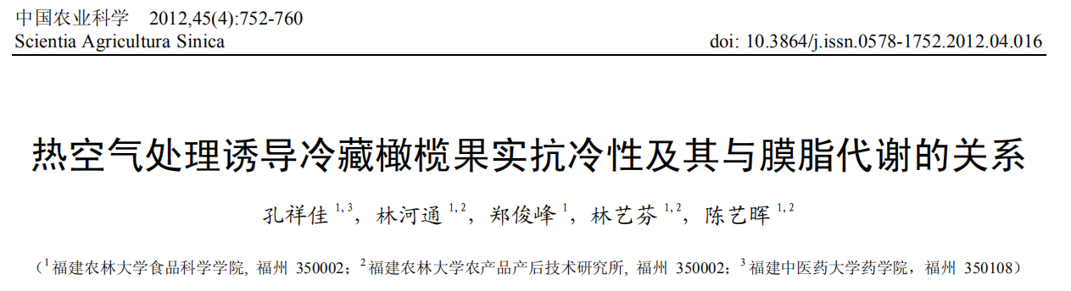
关键词：橄榄；冷害；抗冷性；脂氧合酶；脂肪酸；热空气处理
FOOD SCIENCE COLLEGE OF SYAU
食品学院

Slide 20
摘 要
热处理作为一种无毒、无农药残留的果蔬采后物理处理方法，能通过改变西葫芦、番茄、柿果等果蔬膜脂脂肪酸组分及相对含量而诱导果蔬抗冷性，从而达到控制冷藏果蔬冷害发生而延长果蔬贮藏期的目的。本文以福建主栽橄榄品种‘檀香’橄榄果实为材料，研究经 38℃热空气处理 30 min 的橄榄果实在（2±1）℃冷藏期间的冷害发生情况、LOX 活性和膜脂脂肪酸组分的变化规律，旨在阐明热空气处理诱导冷藏橄榄果实抗冷性及其与 LOX 活性和膜脂脂肪酸组分的关系。
材料和方法
（1）对照（20℃放置 30 min）；（2）热空气处理（38℃热空气处理 30 min）。
每处理重复 3 次，处理后的果实立即用 0.015 mm 厚的聚乙烯薄膜袋密封包装，每袋装果 100 个，每处理30 袋，果实包装后在（2±1）℃下贮藏。
FOOD SCIENCE COLLEGE OF SYAU
食品学院

Slide 21
测量指标
果实冷害指数、果实细胞膜透性、脂氧合酶（LOX）活性测定、膜脂脂肪酸组分测定
结果与讨论
本研究发现，38℃热空气处理 30 min 会降低 2℃下冷藏橄榄果实的冷害指数（图 1），抑制果皮 LOX活性上升（图 3），提高棕榈油酸、亚油酸和亚麻酸等不饱和脂肪酸相对含量（图 4-D、图 4-F、图 4-G），降低肉豆蔻酸、棕榈酸、硬脂酸等饱和脂肪酸相对含量（图 4-A、图 4-B、图 4-C），提高膜脂脂肪酸不饱和指数（图 5-A）和膜脂脂肪酸不饱和度（图 5-B），抑制细胞膜相对电导率的增加（图2）。据此认为，热空气处理降低了果皮中 LOX 活性、抑制不饱和脂肪酸降解、维持较高的膜脂脂肪酸不饱和程度和较大膜流动性，使膜发生相变的温度较低，从而增强冷藏橄榄果实的抗冷性。因此，热空气处理能减轻冷藏橄榄果实冷害的发生。
FOOD SCIENCE COLLEGE OF SYAU
食品学院

Slide 22

结 论
（2±1）℃冷藏会促进橄榄果实果皮 LOX 活性上升，降低果皮棕榈油酸、亚油酸和亚麻酸等不饱和脂肪酸相对含量，增加果皮肉豆蔻酸、棕榈酸、硬脂酸等饱和脂肪酸相对含量，从而降低果皮膜脂脂肪酸的不饱和程度，导致果实抗冷性下降，促进橄榄果实冷害的发生；38℃热空气处理 30 min 通过降低（2±1）℃下冷藏橄榄果实果皮 LOX 活性而减少膜脂不饱和脂肪酸的降解，维持较高的膜脂脂肪酸不饱和程度，从而增强橄榄果实抗冷性、减轻冷藏橄榄果实冷害的发生。
（2±1）℃冷藏会促进橄榄果实果皮 LOX 活性上升，降低果皮棕榈油酸、亚油酸和亚麻酸等不饱和脂肪酸相对含量，增加果皮肉豆蔻酸、棕榈酸、硬脂酸等饱和脂肪酸相对含量，从而降低果皮膜脂脂肪酸的不饱和程度，导致果实抗冷性下降，促进橄榄果实冷害的发生；38℃热空气处理 30 min 通过降低（2±1）℃下冷藏橄榄果实果皮 LOX 活性而减少膜脂不饱和脂肪酸的降解，维持较高的膜脂脂肪酸不饱和程度，从而增强橄榄果实抗冷性、减轻冷藏橄榄果实冷害的发生。
FOOD SCIENCE COLLEGE OF SYAU
食品学院

Slide 23
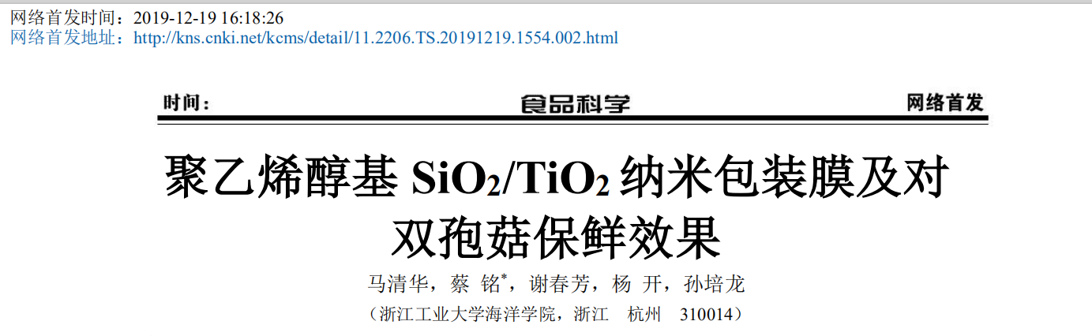
关键词：双孢菇；聚乙烯醇；纳米包装膜；贮藏效果
FOOD SCIENCE COLLEGE OF SYAU
食品学院

Slide 24
摘 要
目前，双孢菇的采后保鲜技术主要集中在气调保鲜、涂膜保鲜、辐照处理和臭氧保鲜等。然而，随着栽培方式的改进以及物流水平的提高，贮藏的要求已经从静态保鲜转向流通运输环节中的动态保鲜，传统的保鲜技术很难满足双孢菇等鲜活农产品的市场需求。纳米保鲜技术是一种绿色、高效、节能的新型保鲜技术，在果蔬保鲜领域的应用已逐渐成为研究热点。与传统包装材料相比，纳米食品包装材料在抑菌、抑制乙烯产生、气体选择透过性等方面具有明显优势，尤其适合鲜活农产品的保鲜贮藏。据报道，采用纳米包装材料可以有效减缓金针菇的品质劣变、延长货架期。本文研制了不同浓度的聚乙烯醇（PVA）基 SiO2/TiO2 纳米包装膜，并分析其结构特性及其对双孢菇贮藏品质的影响，从而探明纳米包装材料在双孢菇保鲜中的应用优势。
FOOD SCIENCE COLLEGE OF SYAU
食品学院

Slide 25
材料和方法
涂膜液的制备
包装膜的制备
透气性测定
薄膜力学性能测定
包装膜：P0（空白对照）、S1（1%纳米 SiO₂添加量）、S2(2%纳米 SiO₂添加量)、T1(1%纳米 TiO₂添加量)、T2(2%纳米 TiO₂添加量)
使用封口机将市售 PE 膜和自制的 5 种纳米包装膜分别制成规格为 140 mm×185 mm 的包装袋。
每袋装取双孢菇 120 g±5 g，记为阳性对照组（PE）（阳性对照组），阴性对照组（P0）和处理组（S1、 S2、T1、T2），用封口机密封保存，温度 10±1℃，相对湿度 90%±2%，贮藏 5 天，每天进行各项指标测定，每组试验重复 3 次。
测定指标包括硬度、白度、失重率、感官评价。
FOOD SCIENCE COLLEGE OF SYAU
食品学院

Slide 26

结 论
PVA基纳米包装膜对双孢菇具有较好的自发气调保鲜效果。与纯PVA相比，1% SiO₂/TiO₂纳米包装膜能明显降低双孢菇的失重率，贮藏第5天失重率分别为降低31.06%和32.87%。由于纳米粒子的添加，改善了包装袋内气体成分，保持了双孢菇较高的硬度及白度。经 1% TiO2纳米复合膜处理的双孢菇具有更高的白度，达86.18。通过开伞程度、颜色、硬度和气味等感官指标评定，1%的TiO2纳米PVA包装膜对双孢菇的保鲜效果最好，贮藏结束得分为7.5分，而PE膜和纯PVA膜仅为6.5分和6.7分。
FOOD SCIENCE COLLEGE OF SYAU
食品学院

Slide 27
THANK YOU !
FOOD SCIENCE COLLEGE OF SYAU
食品学院

